Slide 1
Streaming Content Success Analysis
Presented By
Tharanika Shanmugam

Slide 2





Introduction
Streaming platforms like Netflix, Amazon Prime, and Disney+ have transformed the entertainment industry by providing on-demand access to movies and TV shows across the globe.
These platforms generate massive amounts of data related to content performance, including revenue, ratings, and popularity.
Analyzing this data helps understand viewer preferences, content trends, top-performing genres, and factors influencing success.
Power BI is a powerful data visualization tool that converts raw streaming data into interactive dashboards and reports, enabling better decision-making.

Slide 3
Problem Statement
Streaming content data is large and complex, making it difficult to analyze performance and identify meaningful patterns using traditional methods.
Without proper analysis, it becomes challenging to determine which content performs well and why.
This project aims to develop a Streaming Content Success Analysis Dashboard using Power BI to transform raw data into interactive visualizations for better understanding and decision-making.

Slide 4
Business Problem
How does content performance vary based on budget and revenue?
Which genres generate the highest popularity and revenue?
Which movies or shows are the top performers?
How does content success vary across different regions or countries?
What is the relationship between ratings and popularity?
How do trends change over time year-wise?
Which factors contribute most to content success?

Slide 5
Data Overview
Data Fields:
Title
Genre
Budget
Revenue
Popularity Score
Ratings
Release Year
Country

Slide 6
Technology Used
Data Source: TMDB_movie_dataset_v11 (Kaggle).
Data Preparation & Transformation (ETL):
Power Query: Cleaning and transforming data
Data Modelling:
Creating relationships between tables (Genre, Rating, Production, TimeLine).
Data Analysis & Visualization:
Power BI
Charts: Bar chart, Line chart, Scatter plot, Donut chart.
DAX Measures
Data Insights & Reporting:
Interactive Dashboard
Filters & Slicers for Genre, Year, Region.

Slide 7
Data Preprocessing
The Power Query Editor is used for cleaning and preparing the dataset.
Steps:
Handling missing values in revenue and ratings
Converting data types (text to numeric)
Removing duplicate records
Extracting year from release date
Creating new columns:
Profit = Revenue – Budget.

Slide 8
Key Metrics and KPIs
These KPIs provide a quick overview of content performance:
Total Revenue: Total earnings from all content
Total Content Count: Number of movies/shows analyzed
Average Rating: Overall viewer rating
Average Popularity Score: Measures audience engagement
Total Profit: Total Profit from all content.

Slide 9
Data Modelling Overview
Created relationships between tables such as:
Rating Table
Genre Table
Timeline Table
Production Table
Ensures accurate filtering and aggregation

Slide 10
DAX Measures
DAX (Data Analysis Expressions) is used for calculations:
Total Revenue = SUM(Revenue)
Total Content = COUNT(Title)
Average Rating = AVERAGE(Rating)
Popularity Score = AVERAGE(Popularity)
Profit = SUM(Revenue) – SUM(Budget)

Slide 11
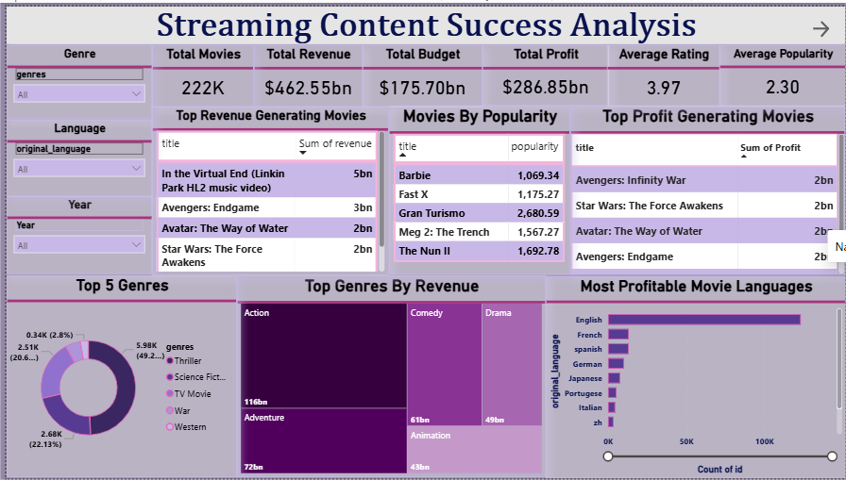
Power BI Dashboard Overview
The dashboard provides an interactive view of:
Content performance
Genre distribution
Revenue trends
Popularity insights
Users can apply filters to analyze data by genre, year, and region.

Slide 12
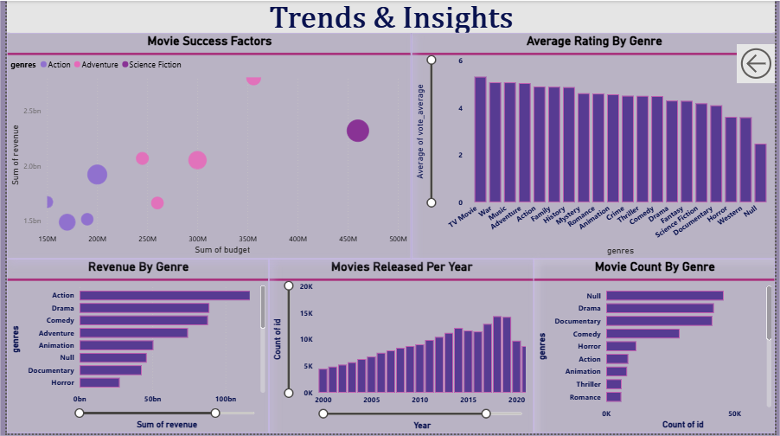
Trends and insights

Slide 13

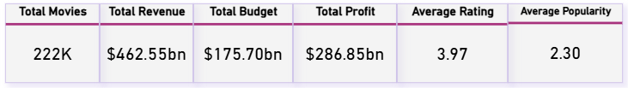

Overall Performance Analysis
The platform has generated $462B revenue with strong profitability.

Slide 14
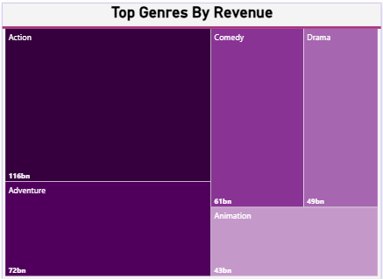
Top Genres Based on Revenue
Tree Map :
Shows revenue of each genre.
Insight:
Action, Adventure and Comedy dominate revenue share.

Slide 15
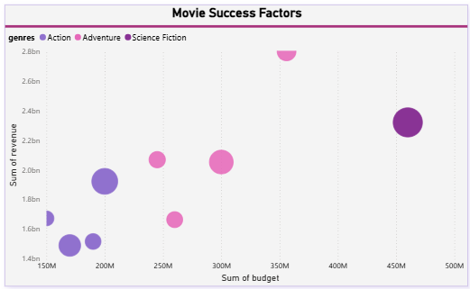
Revenue vs Budget Analysis
Scatter Plot:
X-axis: Budget
Y-axis: Revenue
Insight:
Higher budget often leads to higher revenue, but some
low-budget content performs exceptionally well.

Slide 16
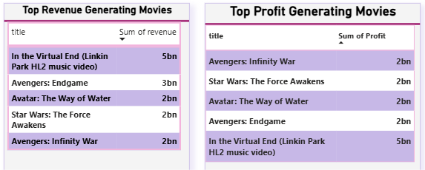
Top Performing Content
Table View:
Top 5 movies/shows by revenue.
Insight:
Few top-performing titles contribute significantly to overall revenue.

Slide 17
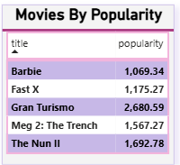
Popularity Analysis
Table View :
Shows Movie analysis by popularity.
Insight: High popularity doesn’t always mean a big budget;
even smaller films can become very popular..

Slide 18
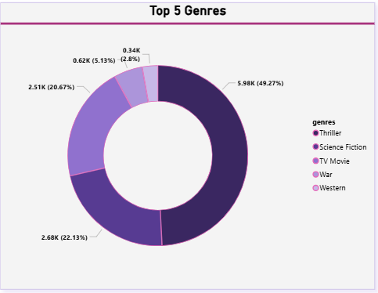
Genre Analysis
Thriller and Science Fiction are popular and leading genres.

Slide 19
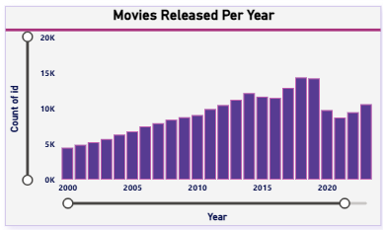
Year-wise Trend Analysis
Column Chart:
Shows number of releases over time
Insight: Content production has increased significantly in recent years.

Slide 20
Key Insights Summary
Action genre → highest revenue
Budget → strong correlation with revenue
English → dominant language
Increasing trend in content production

Slide 21
Conclusion
The Streaming Content Success Dashboard provides valuable insights into content performance, genre trends, and audience preferences.
It helps identify key factors such as budget, genre, and ratings that influence success.
These insights enable streaming platforms to make better decisions in content production and marketing strategies.

Slide 22
Thank YOU

